Slide 1
CS 447/647
TCP/IP Networking

Slide 2
###[ Ethernet ]###
dst = FF:FF:FF:FF:FF:FF
src = aa:00:00:fb:6c:78
type = ARP
###[ ARP ]###
hwtype = 0x1
ptype = IPv4
hwlen = None
plen = None
op = who-has
hwsrc = aa:00:00:fb:6c:78
psrc = 10.0.120.199
hwdst = 00:00:00:00:00:00
pdst = 10.0.120.1

Slide 3
News
Over 20 thousand servers have their iLO interfaces exposed to the internet, many with outdated and vulnerable versions of FW Published: 2022-01-26
"A lot of devices and services we have seen during our research should never be connected to the public Internet at all. As a rule of thumb, if you believe that "nobody would connect that to the Internet, really nobody", there are at least 1000 people who did. Whenever you think "that shouldn't be on the Internet but will probably be found a few times" it's there a few hundred thousand times. Like half a million printers, or a Million Webcams, or devices that have root as a root password."
http://census2012.sourceforge.net/paper.html

Slide 4
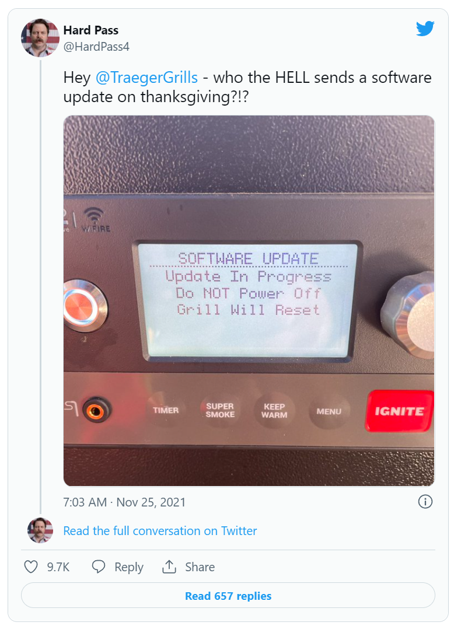

Slide 5
What are the core Internet Protocols? (IP, ICMP, UDP, and ARP)
How is the Internet governed? (ICANN, ISOC and IGF)
How are standards developed? (RFC)
What are the 5 layers of the TCP/IP Model?

Slide 6
References
Goralski, W. (2017). The Illustrated Network: How TCP/IP works in a modern network. Amsterdam: Elsevier.
https://learning.oreilly.com/library/view/the-illustrated-network/9780128110287

Slide 7
TCP/IP Networking
TCP/IP underpins the Internet
Web
Email
Zoom (TCP+UDP)
TCP/IP is flexible
OS Independent
Hardware Independent
Works on any size or topology

Slide 8
TCP/IP Networking & The Internet
TCP/IP and the Internet have a shared history
TCP was created in 1974 by Vint Cerf
https://www.cs.princeton.edu/courses/archive/fall06/cos561/papers/cerf74.pdf
Progenitor was a network called ARPANET in 1969
In the 1980’s in transitioned into the commercial Internet
Collaboratively Managed
ICANN - Internet Corporation for Assigned Names and Numbers
Enforcement Capabilities
Controls the allocation of IPs, domains and protocol ports.
ISOC - Internet Society
Technical development through IETF - Internet Engineering Task Force
IGF - Internet Governance Forum
Created by the UN.
Used for policy-based discussions

Slide 9
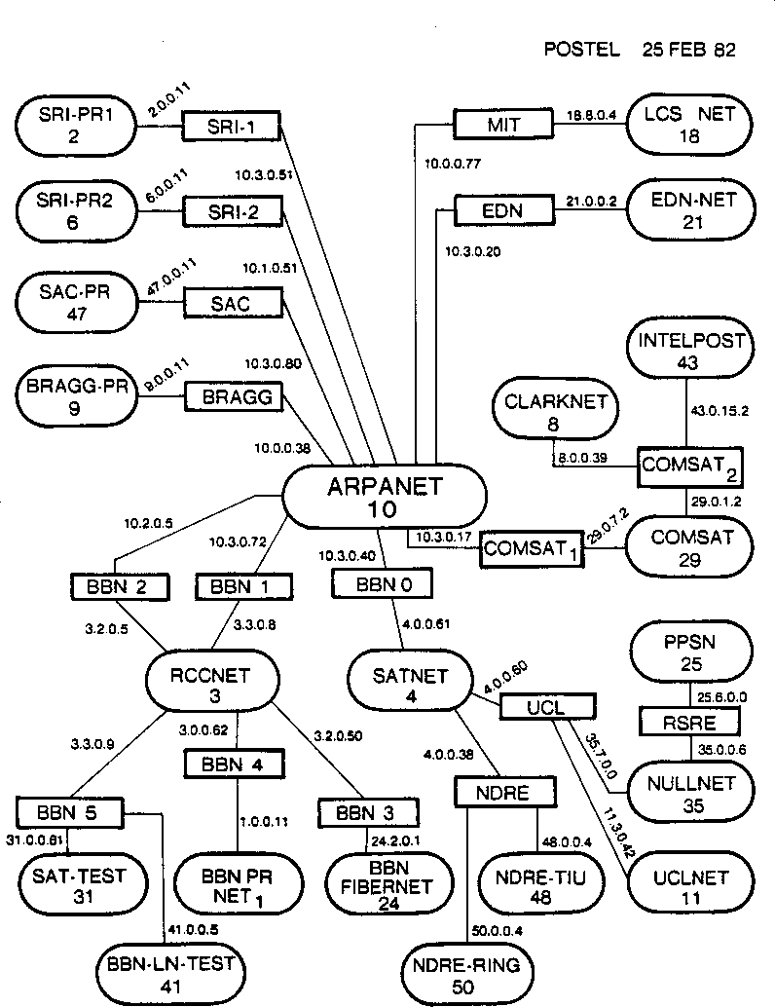

Slide 10
Internet Governance
Collaboratively Managed
ICANN - Internet Corporation for Assigned Names and Numbers
Enforcement Capabilities
Controls the allocation of IPs, domains and protocol ports.
ISOC - Internet Society
Technical development through IETF - Internet Engineering Task Force
IGF - Internet Governance Forum
Created by the UN.
Used for policy-based discussions

Slide 11
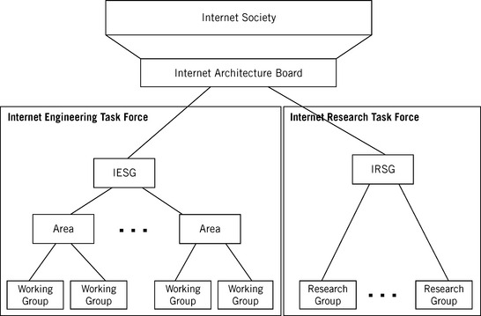
Internet Engineering Steering Group
Routing Security
https://datatracker.ietf.org/wg/
Notes:
Internet Society (ISOC)—This is an international nonprofit organization formed in 1992 to support the Internet standards process. ISOC maintains and supports the other administrative bodies described in this section. ISOC also supports research and scholarly activities relating to the Internet.
Internet Architecture Board (IAB)—This group is the technical advisor to ISOC. The IAB oversees the continued development of the Internet protocol suite and plays a technical advisory role to members of the Internet community involved in research. The IAB does this primarily through the two organizations under it. In addition, the RFC editor derives authority from the IAB, and the IAB represents the Internet to other standards organizations and forums.
Internet Engineering Task Force (IETF)—This a forum of working groups managed by the Internet Engineering Steering Group (IESG). The IETF identifies operational problem areas and proposes solutions. They also develop and review the specifications intended to become Internet standards. The working groups are organized into areas devoted to a particular topic. Nine areas have been defined, although this can change: applications, Internet protocols, routing, operations, user services, network management, transport, IPv6, and security. The IETF has taken on some of the roles that were invested in ISOC.
Internet Research Task Force (IRTF)—This is another forum of working groups, organized directly under the Internet Research Steering Group (IESG) for management purposes. The IRTF is concerned with long-term research topics related to Internet protocols, applications, architecture, and technology.
Two other groups are important for Internet administration, although they do not appear in Figure 1.7.
Internet Corporation for Assigned Names and Numbers (ICANN)—This is a private nonprofit corporation that is responsible for the management of all Internet domain names (more on these later) and Internet addresses. Before 1998, this role was played by the Internet Assigned Numbers Authority (IANA), which was supported by the U.S. government.
Internet Network Information Center (InterNIC)—The job of the InterNIC, run by the U.S. Department of Commerce, is to collect and distribute information about IP names and addresses. They are at http://www.internic.net.

Slide 12
Network standards and documentation
RFCs - Request for Comments
Protocol Standards
TFTP, SMTP, HTTP, DNS, etc.
Proposed Changes
SMTP Require TLS Option - REQUIRETLS
https://www.rfc-editor.org/rfc/rfc8689.txt
Informational Bulletins
50 years of RFCs
https://www.rfc-editor.org/rfc/rfc8700.txt
RFCs can be assigned
BCP - Best Current Practice
Network Time Protocol Best Current Practices
STD - Standard
FYI - For Your Information
Notes:
FYIs are introductory or informational documents intended for a broad audience. They can be a good place to start research on an unfamiliar topic if you can find one that’s relevant. Unfortunately, this series has languished recently and not many of the FYIs are up to date.
BCPs document recommended procedures for Internet sites. They consist of administrative suggestions and for system administrators are often the most valuable of the RFC subseries.
STDs document Internet protocols that have completed the IETF’s review and testing process and have been formally adopted as standards.

Slide 13
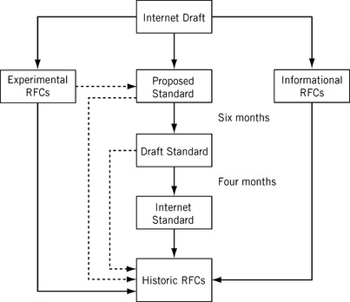
Notes:
Proposed standard—The specification is now well understood, stable, and sufficiently interesting to the Internet community. The specification is now usually tested and implemented by several groups, if this has not already happened at the draft level.
Draft standard—After at least two successful and independent implementations, the proposed standard is elevated to a draft standard. Without complications, and with modifications if specific problems are uncovered, draft standards normally become Internet standards.
Internet standard—After demonstrations of successful implementation, a draft standard becomes an Internet standard.
Experimental RFCs—Not all drafts are intended for the “standards track” (and a huge number are not). Work related to an experimental situation that does affect Internet operation comprise experimental RFCs. These RFCs should not be implemented as part of any functional Internet service.
Informational RFCs—Some RFCs contain general, historical, or tutorial information rather than instructions.

Slide 14
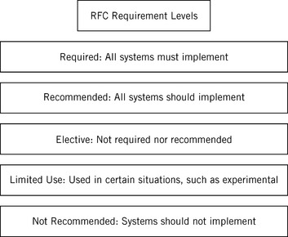
Notes:
conformance. For example, IPv4 and ICMP, both discussed in detail in this book, are required protocols. However, there are very few required RFCs.
Recommended—These RFCs are not required for minimum conformance, but are very useful. For example, FTP is a recommended protocol.
Elective—RFCs in this category are not required and not recommended. However, systems can use them for their benefit if they like, so they form a kind of “option set” for Internet protocols.
Limited Use—These RFCs are only used in certain situations. Most experimental RFCs are in this category.
Not Recommended—These RFCs are inappropriate for general use. Most historic (obsolete) RFCs are in this category.

Slide 15
Networking Basics - Protocol Suite
IP - Internet Protocol
Routes data from one machine to another
ICMP - Internet Control Message Protocol
Low-level support for IP error message, routing and debugging
ping, traceroute
ARP - Address Resolution Protocol
Translates IP to hardware address (MAC)
UDP - User Datagram Packet
Unreliable one-way delivery
TCP - Transmission Control Protocol
Reliable full-duplex and error corrected conversations

Slide 16
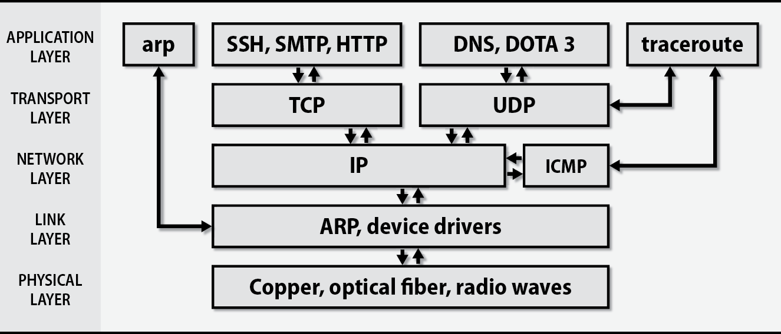
TCP/IP Layering model
Notes:
Physical Layer: Contains all the functions needed to carry the bit stream over a physical medium to another system.
Data Link Layer: Organizes the bit stream into a data unit called a “frame” and delivers the frame to an adjacent system.
Network Layer: Delivers data in the form of a packet from source to destination, across as many links as necessary, to non-adjacent systems.
Transport Layer: Concerned with process-to-process delivery of information.
Application Layer: Concerned with differences in internal representation, user interfaces, and anything else that the user requires.

Slide 17
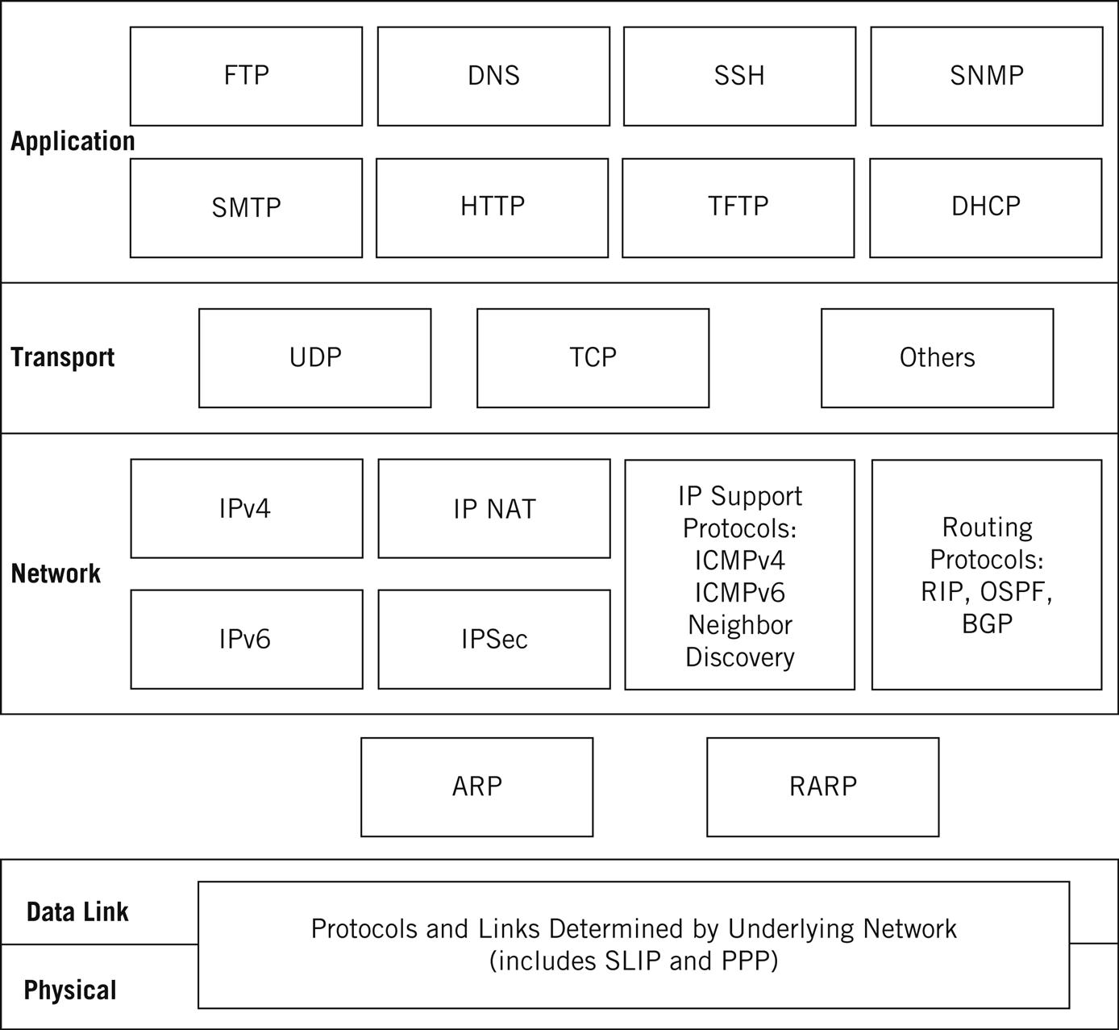
Notes:
ARP resolves an IP address to a MAC address
RARP: the opposite

Slide 18
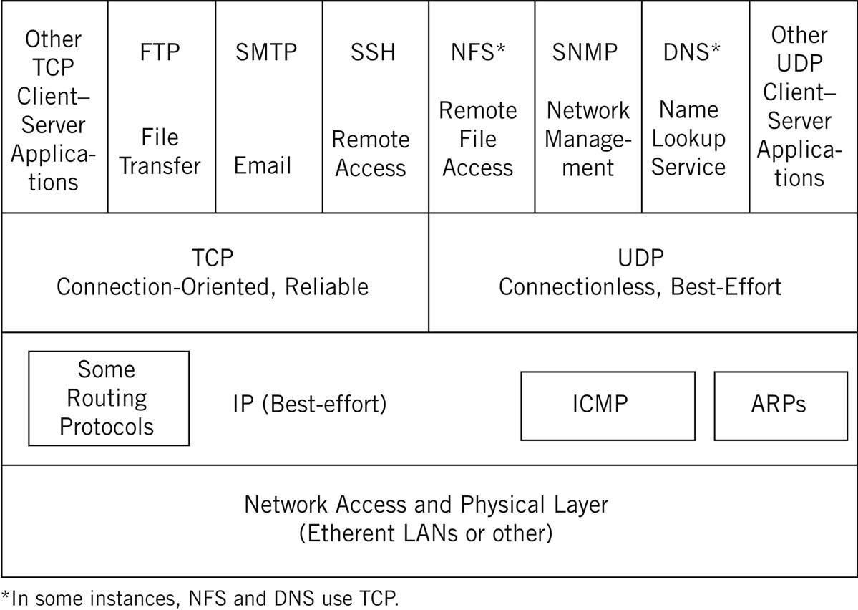

Slide 19
IPv4 and IPv6
IPv4
32 bit addresses
4,294,967,296 addresses
NAT - Network Address Translation
IPv6
128 bit addresses
IPsec - built in authentication and encryption
No checksum
30% of google.com visits
Adoption of IPv6 is slow
Amazon, Bing, Wordpress, craigslist
Waiting for services to be IPv6 only
Cleaned up version of IPv4
Python2
2010 to 2020

Slide 20
Packet Encapsulation
Hardware
Ethernet, token ring, Infiniband, Omni-path
Data travels as packets
Max length is dictated by the link layer (2)
Packet header has source and destination
Checksums, protocol options
Handling instructions (TTL)
Payload
Encapsulation
Packets are added to by each layer by the sender
Each layer is removed by the receiver

Slide 21
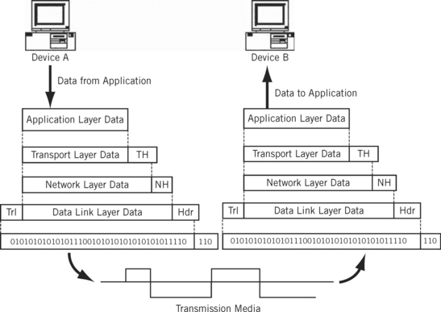
Notes:
The frame header typically contains a source and destination address (known as the “physical address” since it refers to the physical communication port) and some control information. The control information is data passed from one data link layer to the other data link layer, and not user data. The body of the frame contains the sequence of bits being transferred across the network. The trailer usually contains information used in detecting bit errors (such as cyclical redundancy check [CRC]). A maximum size is associated with the frame that cannot be exceeded because all systems must allocate memory space (buffers) for the data. In a networking context, a buffer is just special memory allocated for communications.

Slide 22
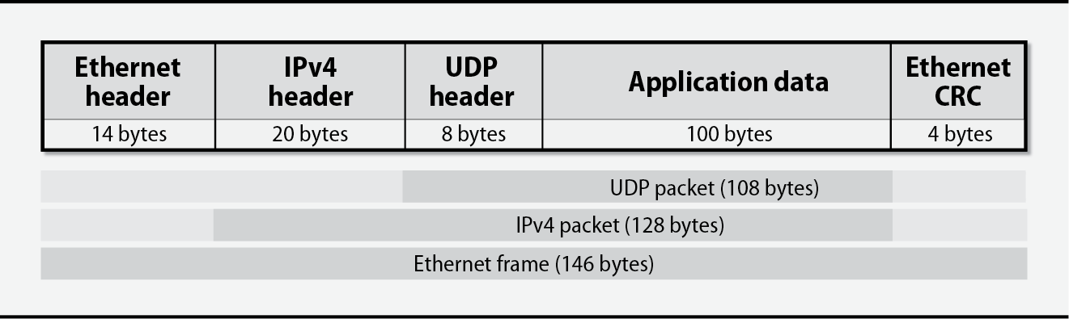
Notes:
Ethernet header - layer 2, contains MAC addresses for source and destination, as well as ethertype (IPv4 here)
IPv4 header - layer 3, contains source/destination IP addresses, TTL, and protocol (UDP here)
UDP header - layer 4 header, containing source/destination ports
CRC - cyclic redundancy check, used for error-correction

Slide 23
Ethernet Framing
Adding extra bits to a packet
Link layer adds headers to packets
Header contains addresses
Checksums
Link layer adds separators between packets
Two parts of link layer
Media Access Control - Deals with hardware, puts packets onto the wire
Logical Link Control - Ethernet framing
Notes:
Bits are just bits. With only a physical layer, System A has no way to tell System B, “Get ready some bits,” “Here are the bits,” and “Did you get those bits okay?” The data link layer solves this problem by organizing the bit stream into a data unit called a frame.

Slide 24
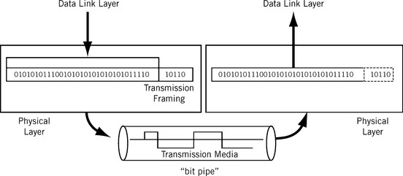
Physical

Slide 25
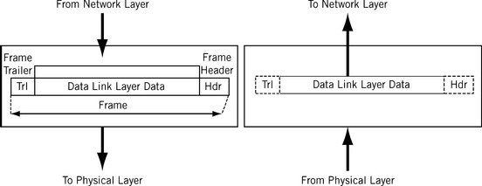
Data Link
Notes:
The frame header typically contains a source and destination address

Slide 26
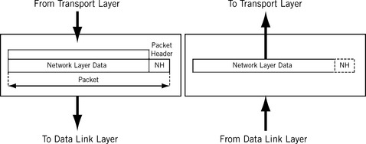
Network
Notes:
The network layer delivers data in the form of a packet from source to destination, across as many links as necessary. The biggest difference between the network layer and the data link layer is that the data link layer is in charge of data delivery between adjacent systems (directly connected systems one hop away), while the network layer delivers data to systems that are not directly connected to the source.
There can be many different types of data link and physical layers on the network, depending on the variety of the link types, but the network layer is essentially the same on all systems, end systems, and intermediate systems alike.

Slide 27
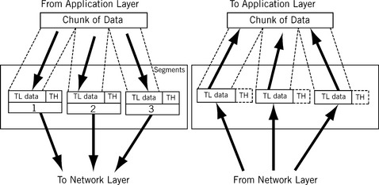
Transport
Notes:
Process-to-process delivery is the task of the transport layer. Getting a packet to the destination system is not quite the same thing as determining which process should receive the packet’s content. A system can be running file transfer, email, and other network processes all at the same time, and all over a single physical interface. Naturally, the destination process has to know on which process the sender originated the bits inside the packet in order to reply. Also, systems cannot simply transfer a huge multimegabit file all in one packet. Many data units exceed the maximum allowable size of a packet.
In TCP/IP, it is often said that the network layer (IP itself) offers an “unreliable” or “best effort” service, while the transport layer adds “reliability” in the form of flow and error control. Later in this book, we’ll see why these terms are unfortunate and what they really mean.

Slide 28
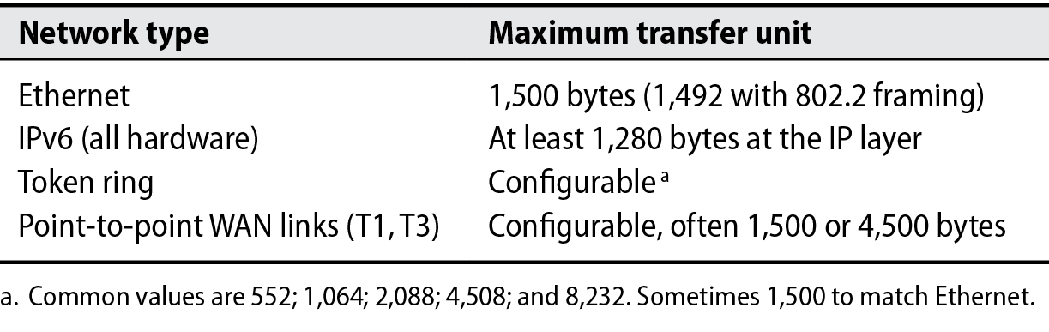
Maximum Transfer Unit
Packet size is limited
Hardware
E1000 - 16,298 bytes
Protocol
Ethernet - 1500 bytes

Slide 29
MTU
IPv4 Packets are split to conform to the MTU
Test with
ping -s 4500 google.com
Fragmentation happens in-flight by routers
IPv6 moves this to the sender
Lowest MTU link can be found with “do not fragment” flag
ICMP error response
Contains network info for lowest-MTU link
TCP does automatic MTU discover
UDP does not

Slide 30
Packet Addressing
MAC Address
Hardware
IPv4 and IPv6 addresses
Software
Hostnames
Humans

Slide 31
Hostnames
Domain Name System (DNS)
A - IPv4
AAAA - IPv6
PTR - IP to Hostname aka. Reverse lookup
/etc/hosts (Windows: C:\Windows\System32\drivers\etc\hosts)
IP hostname hostname1 hostname2
Lookup with dig
dig A google.com
dig A cse.unr.edu @8.8.8.8
dig A cse.unr.edu @134.197.5.1

Slide 32
Ports
IP is an address. IE: 127.0.0.1
Port is a communication channel for an application
1 - 65,535
IP + Port = Socket
127.0.0.1:80 = HTTP
/etc/services defines common network services
grep daytime /etc/services
Ports < 1024 reserved for root

Slide 33
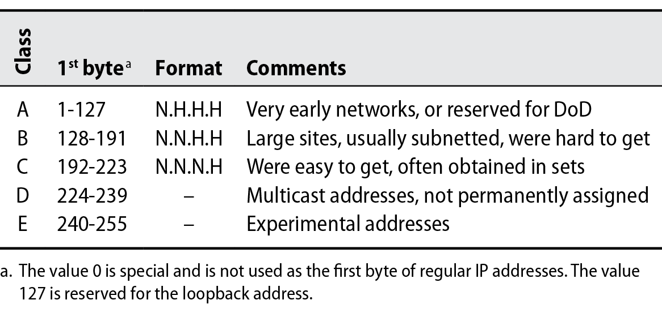
IPv4 Address Classes
Notes:
A - 16 million
B - 65,000
C - 256

Slide 34



IPv4 Subnetting

Slide 35
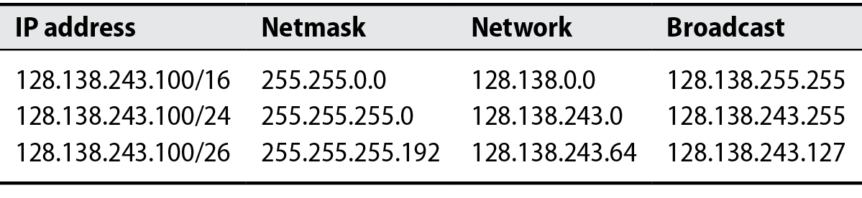
192 = 1100 0000
Notes:
65,536
256
64

Slide 36
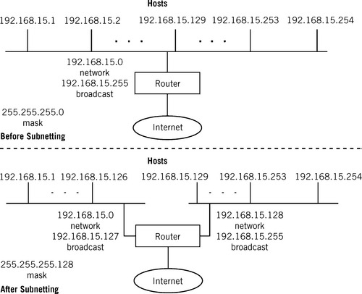

Slide 37
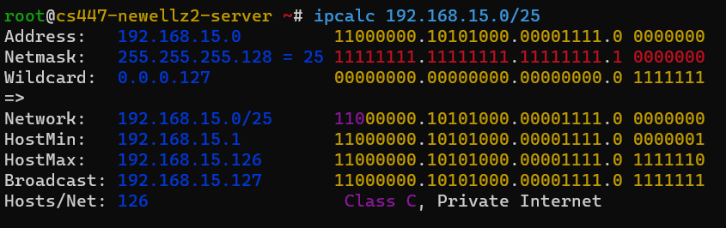
IPv4 Subnetting
apt install ipcalc

Slide 38
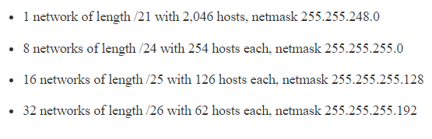
Classless Inter-Domain Routing (CIDR)
Splitting networks for routing purposes
Example
Site has been given a block of eight class C addresses numbered 192.144.0.0 through 192.144.7.0
Notes:
CIDR was an immediate answer to two problems: first, the impending exhaustion of the Class A and Class B address space, and second, the rapid increase in Internet core routing table sizes to handle the many Class C addresses required to handle new users.

Slide 39
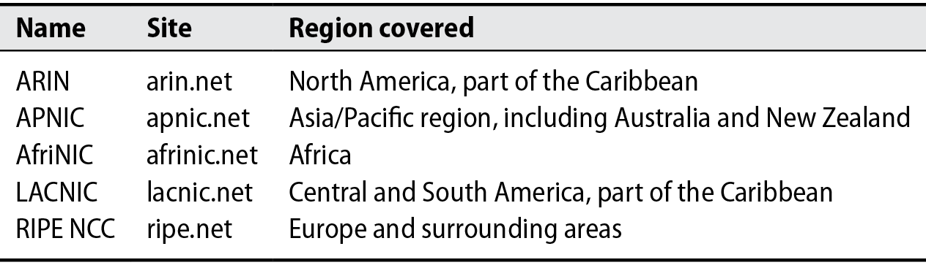
Address Allocation
Notes:
ICANN deleted 5 blocks

Slide 40
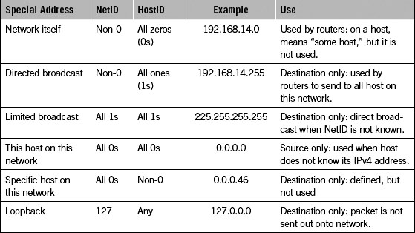
Special forms of IPv4 Addressing

Slide 41
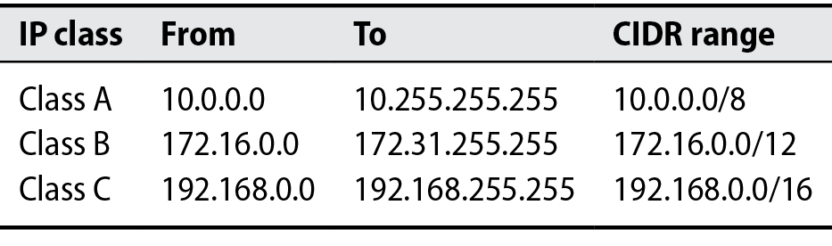
Network Address Translation
Made to deal with IPv4 exhaustion
Private address spaces
Border router translates between private and public

Slide 42
Routing
Direct a packet to its destination
To reach network A
Send packets through machine C
Default route
Often the gateway assigned by DHCP
ip route show

Slide 43
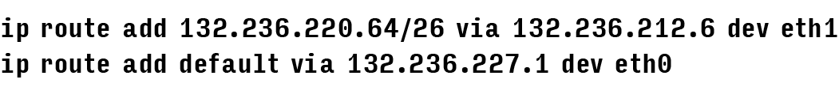

Slide 44
Dynamic Host Control Protocol
Enables automatic
IP Address
Netmask
Gateway
DNS Server configuration
Offers a lease
Expires after a configurable amount of time
Must be renewed
Software
isc-dhcp-server
dnsmasq - simple

Slide 45
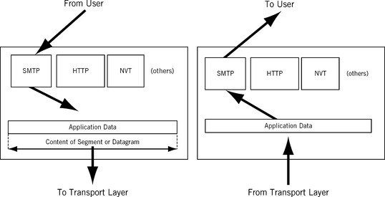

Slide 46
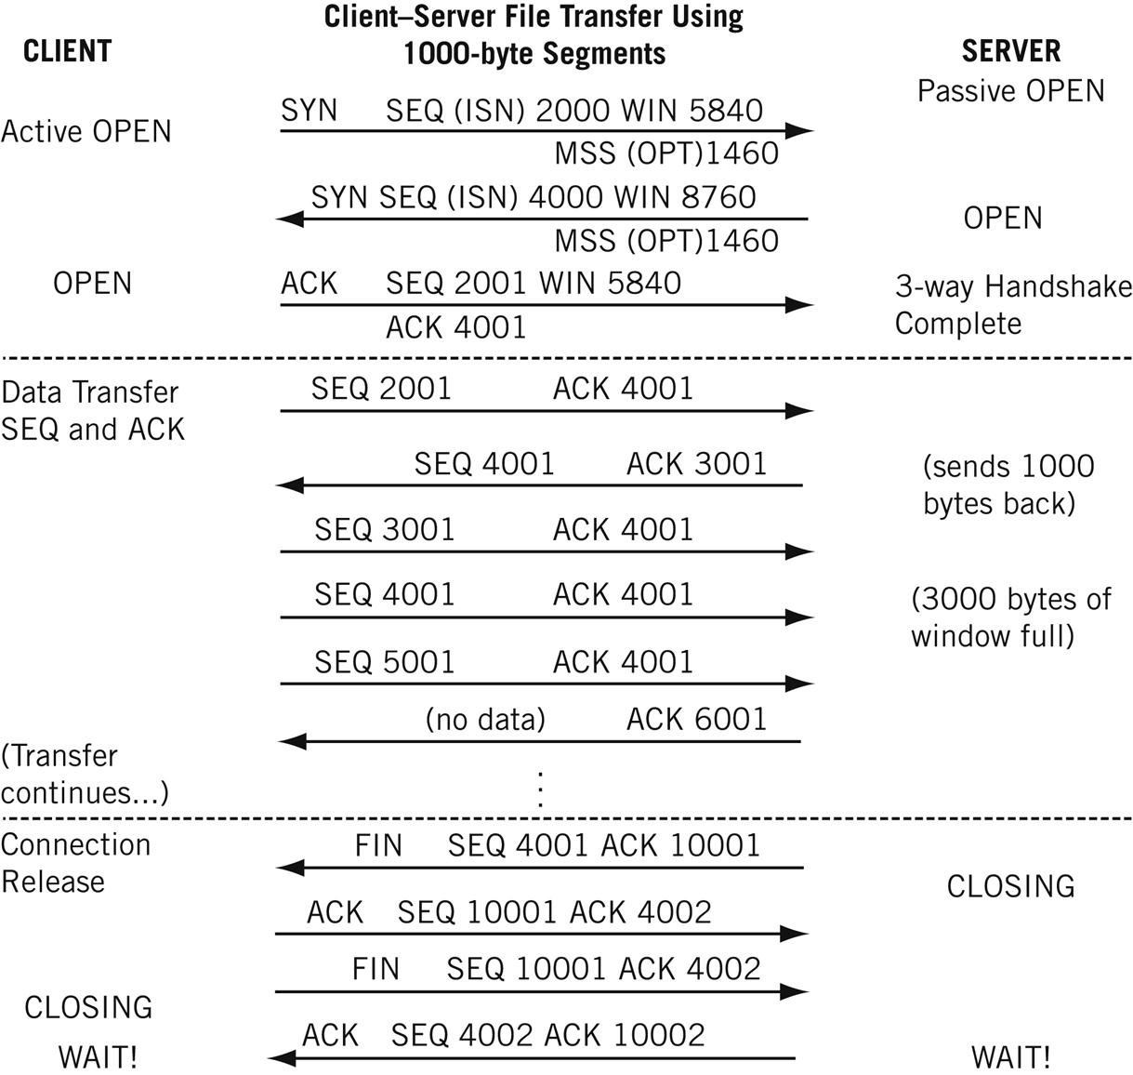
Notes:
Why three ways? Because packets containing the TCP segment that ask a server to accept another connection and the server’s response might be lost on the IP router network, leaving the hosts unsure of exactly what is going on. The third message adds to the overall reliability.

Slide 47
Basic Network Configuration
ip link set eth0 up
ip add 192.168.47.20/24 dev eth0
ip route add default via 192.168.47.1
# Setup DNS Modify
/etc/resolv.conf
/etc/systemd/resolved.conf

